Slide 1
Full Flow: Optical Flow Estimation By Global Optimization over Regular Grids
Qifeng Chen
Stanford University
Vladlen Koltun
Intel Labs
Notes:
Good morning, everyone. I am Qifeng Chen. Today I will present our joint work with Vladlen Koltun. Our paper is Full Flow: Optical Flow Estimation By Global Optimization over Regular Grids.

Slide 2


Optical flow
Motion field between two image frames
Notes:
The goal of optical flow estimation is to compute the motion field between two image frames.
For example, these are two adjacent image frames in the Sintel dataset.

Slide 3
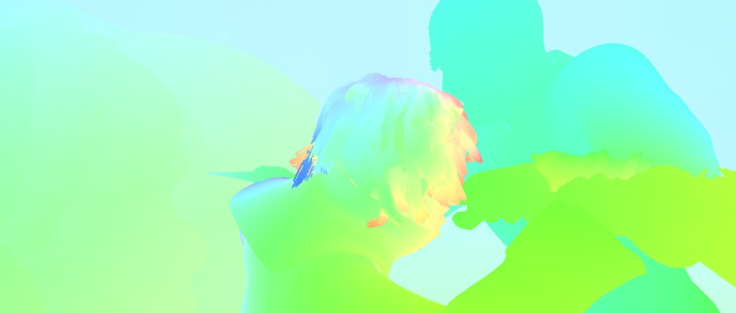
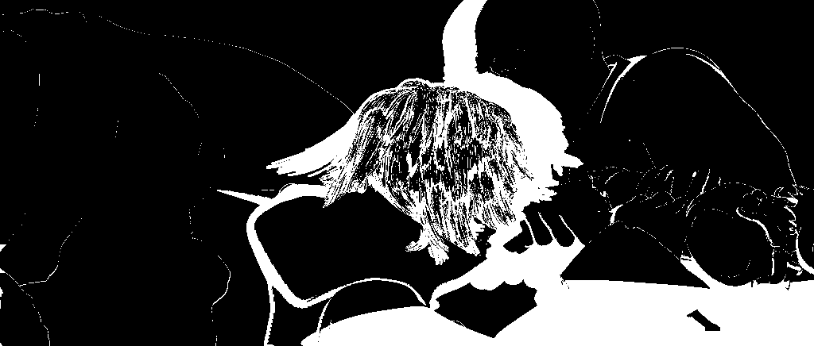
Optical flow
Motion field between two image frames
Image 1
Image 2
optical flow
occlusion map
Notes:
At the bottom, the left image is the visualization of optical flow between Image 1 and Image 2, and the right image is the occlusion map. Notice that some pixels in Image 1 are occluded in Image 2 but we also need to estimate the motion of occluded pixels.

Slide 4

Variational optimization
Classical Horn-Schunck Model
E_{data}
E_{reg}
Smooth
Notes:
The variational approach to optical flow starts with the classical Horn and Schunck model. This classical approach is to optimize an objective of a data term and a regularization term. The data term assumes brightness constancy, meaning that corresponding pixels should have similar colors. The regularization term assumes that the optical flow should be smooth.

Slide 5
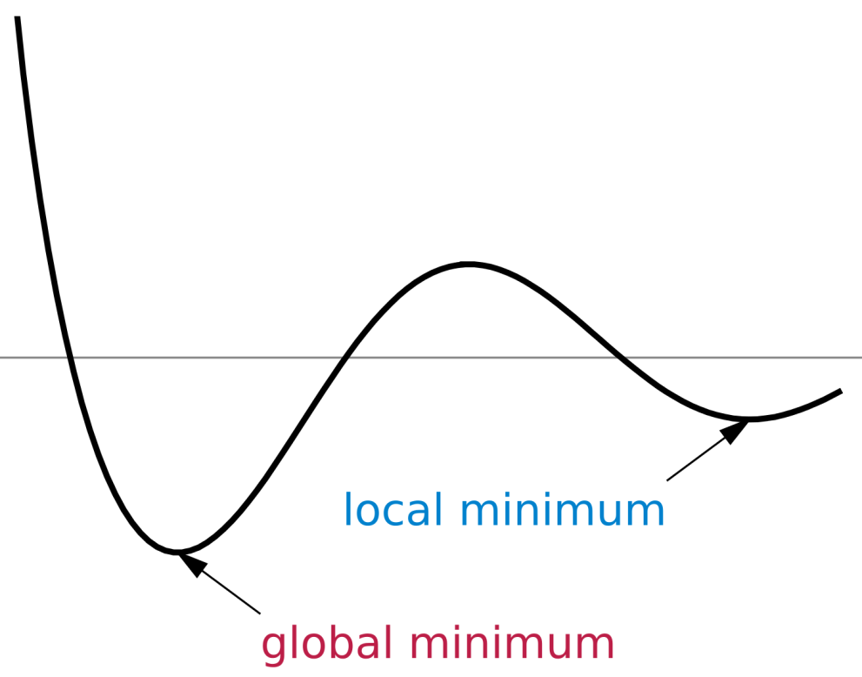


Variational optimization
Gradient-based optimization
Notes:
To optimize the objective, classical methods update the flow by gradient-based steps, starting with some initialization. Through these steps, a single candidate flow is maintained. While this local refinement approach can be accurate when displacements are small, it does not optimize the objective globally over the full space of flows and is prone to local minimum

Slide 6
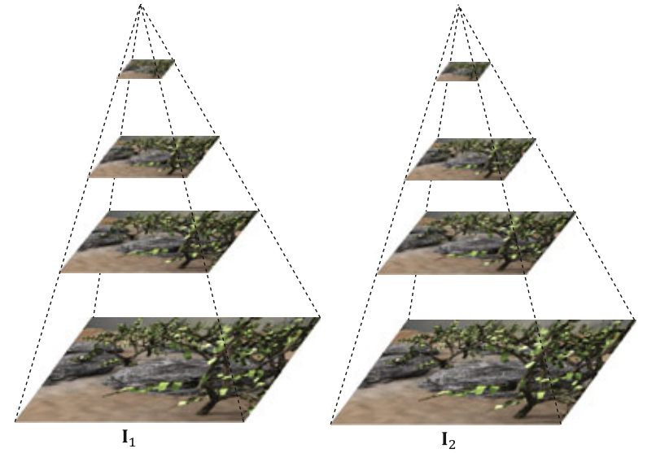
Variational optimization
Coarse-to-fine
Credit: Deqing Sun et al. 2014
Notes:
Some approaches use coarse-to-fine estimation to deal with large displacements. The idea is to solve the optical flow problem in a coarse level first, and then use the solution as initialization in a finer level. However, the errors in coarse levels can be propagated to finer levels.

Slide 7
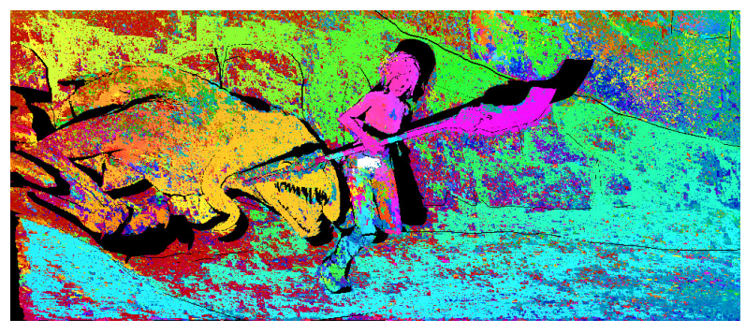
Variational optimization
Initialized by descriptor matching
Credit:Bailer et al. 2015
Notes:
Recent approaches used descriptor matching to initialize the optical flow. This more complicated initialization can improve results with large displacements. However, the descriptor matching module is trained separately, and does not optimize a coherent objective over the provided correspondence sets, and can produce suboptimal initializations.

Slide 8
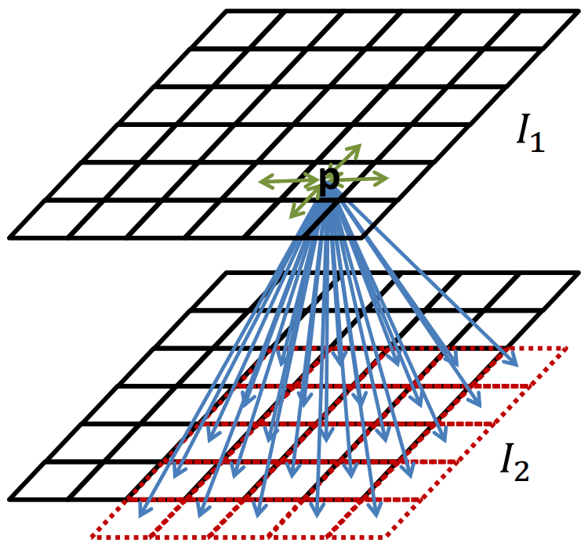
Our approach: global optimization
  Full space of mappings
  State-of-the-art
  Simple and general
Notes:
Our approach globally optimizes a classical Horn-Schunck-type objective over the full space of mappings between discrete grids. The highly regular structure of the mappings supports efficient matching from tens of thousands of nodes to tens of thousands of displacements.
We show that one-shot global optimization over regular grids at one single resolution is sufficient to achieve state-of-the-art performance.
Our code is less than 50 lines long, not including the general purpose solver.

Slide 9
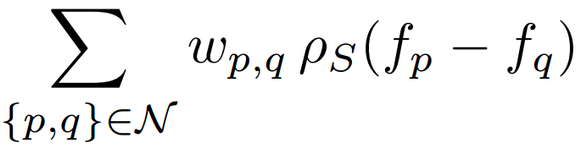
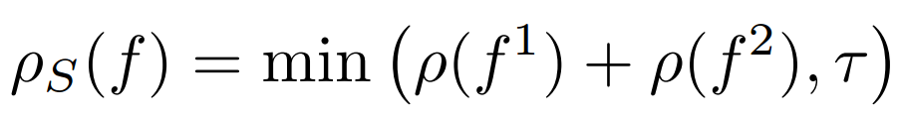

Model
$$E_{reg}\left(f\right)=$$
Notes:
Now I will talk about our Horn-Schunck-type model. For the data term, we simply use truncated normalized cross-correlation between two 3x3 patches. No descriptor is used.
Our optimization approach assumes that the regularization term has the form of ρS where f1 , f2 are the two components of vector f and ρ is a penalty function, such as the L 1 or Charbonnier penalty.

Slide 10
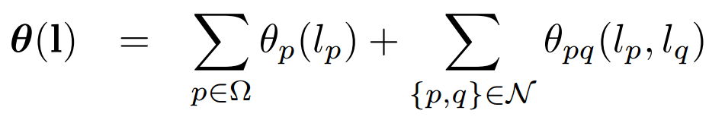
Optimization
Discrete MRF
  labels are displacements on a grid
Image 1
Image 2
Notes:
Now I talk about how to optimize the objective. First we can rewrite the objective as an equivalent discrete MRF problem.
We assume the labels are displacements on a regular grid. For example, each pixel on image 1 has labels on 5x5 regular grid lying on image 2.

Slide 11
Optimization
Inference challenge (TRWS)
  M = tens of thousands of labels
  each message update costs O(M²)
  tens of thousands of messages
O(M) solution
Days → Seconds
Notes:
To optimize the model, we use TRW-S because it is effective in optimizing models with large label set.
However, the MRF problem is still very large with tens of thousands of labels.
A brute-force implementation of a message update requires O(M^2) operations where M is the number of labels, and we have tens of thousands of messages to update.
Instead of quadratic complexity, we have a linear-time solution for message update. This reduces the total running time from days to seconds.

Slide 12
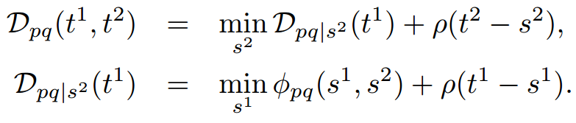
Complexity reduction
2D min convolution
1D min convolution
Notes:
Note that labels are 2D vectors. The key idea of complexity reduction is that 2D min convolution in message update can be reduced to a set of 1D min convolution. We make use of the assumption that the regularization term is in the form of rho_S
1D min convolution can be evaluated in linear time for some ρ functions , for a total complexity of O(M)

Slide 13
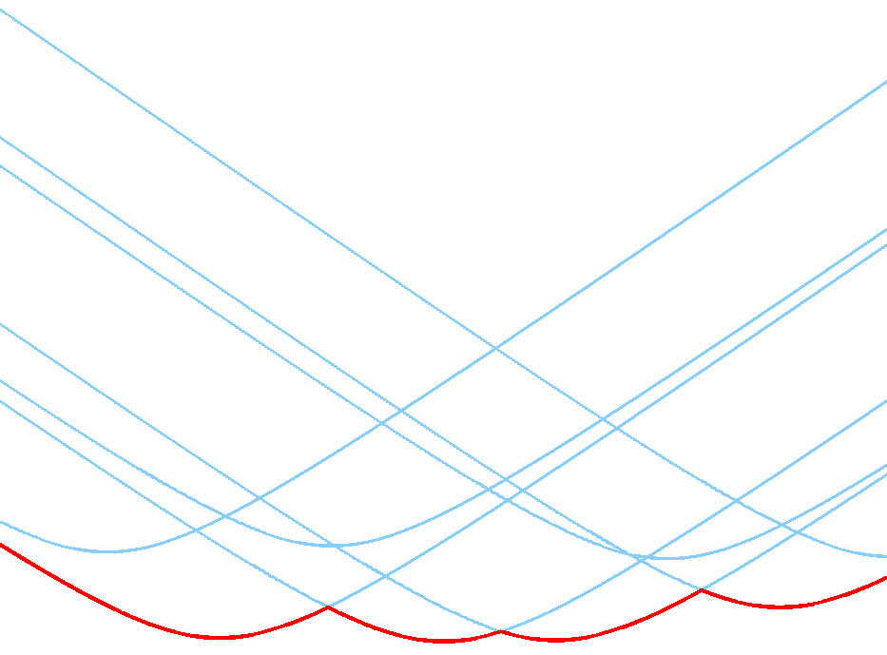
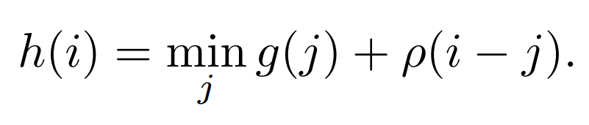

Further acceleration
Linear algorithm (convex $ρ$)
  computing intersections of shifted functions [Felzenszwalb and Huttenlocher 2012]
  totally monotone matrix searching without computing intersections [Aggarwal et al. 1987]
1D min convolution
(lower envelope, distance transform)
Notes:
1D min convolution is also known as lower envelope or distance transform in other literature.
The min-convolution can be computed in linear time, when ρ is convex.
However, commonly used algorithms require computing intersections of shifted copies of the function ρ. This computation can be numerically intensive for some penalty functions.
In fact, we can use an alternative algorithm, called totally monotone matrix searching, to compute the min-convolution without computing intersections. With this algorithm, it is much easier to try different models because we do not need to write separate functions to compute intersections for different ρ functions.

Slide 14
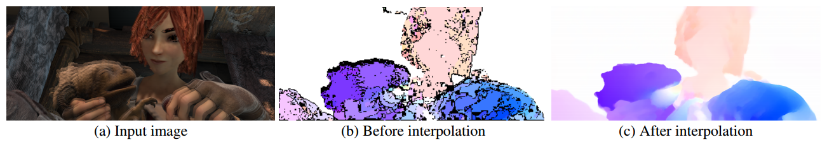
Implementation
Parallel TRW-S
  6.6x speedup
Occlusion handling
  forward-backward consistency checking
Post processing
  Dense interpolation by EpicFlow
Notes:
To improve the speed, we implemented a parallel TRW-S solver. We improve the speed by a factor of 6.6.
To handle occlusion, we adopt forward-backward consistency checking: compute the forward flow and the backward flow, and discard inconsistent matches.
After removing inconsistent matches, we interpolate the results to get subpixel-resolution flow. We use the EpicFlow interpolation.

Slide 15
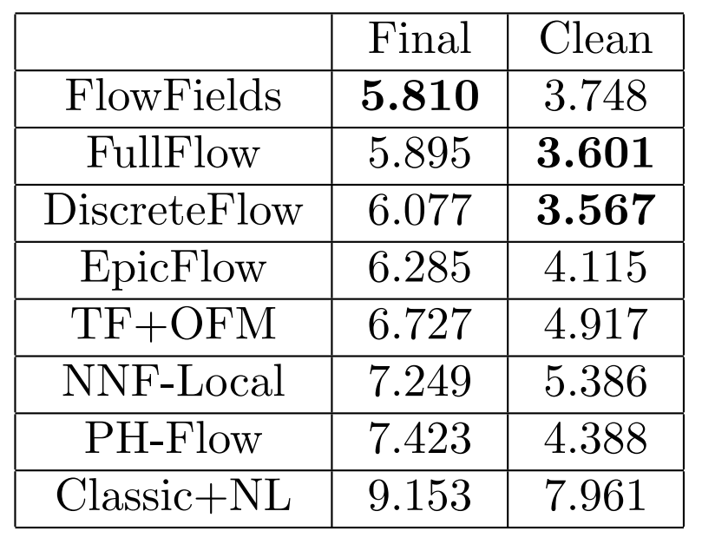
Experiments
MPI-Sintel
  Full flow ranks 2nd
Endpoint errors over all pixels
Notes:
Now I will talk about the experiment results. MPI Sintel is a dataset for large-displacement optical flow. There are two types of sequences in the dataset, clean and final. The clean sequences have illumination and shading effects including specular reflectance and soft shadows. The final sequences additionally have motion blur, depth of field effects.
Our approach ranks 2nd on the key metric, endpoint error over all the pixels, for both final and clean sequences.

Slide 16
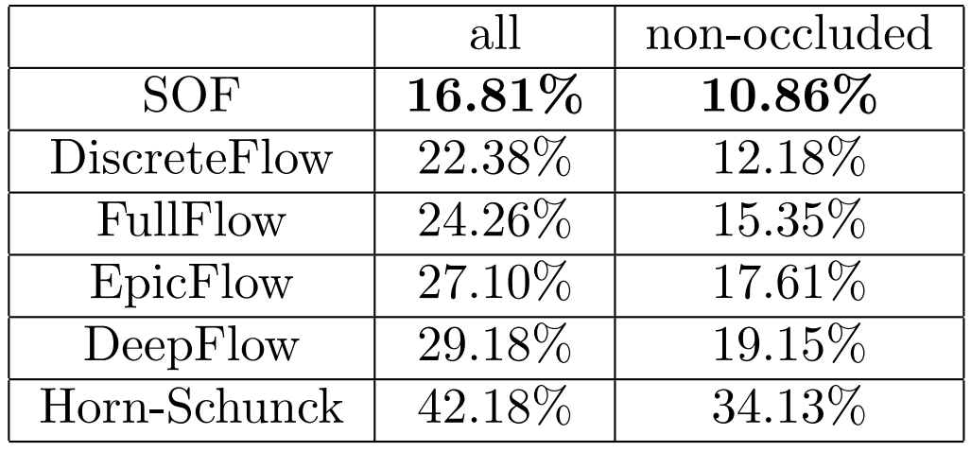
Experiments
KITTI 2015
Accuracy of different methods on the KITTI 2015 test set
Notes:
KITTI Optical Flow 2015 is an optical flow dataset that includes outdoor images of dynamic scenes captured from a car equipped with a LiDAR sensor and color cameras.
Ground-truth flow is obtained by rigid alignment of the static environment and by fitting CAD models to moving objects.
Our approach ranks 3rd in the table. Notice that the first method SOF was developed concurrently with our work and uses substantially more information at training time.

Slide 17
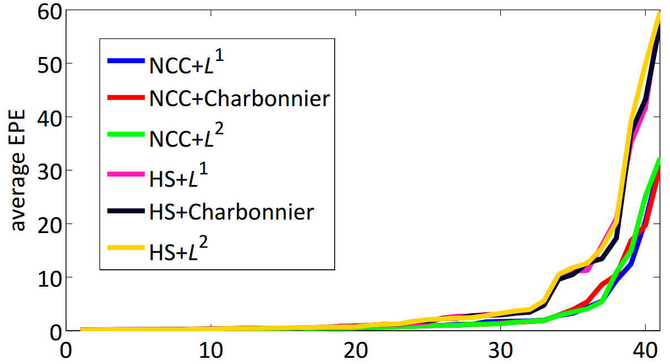
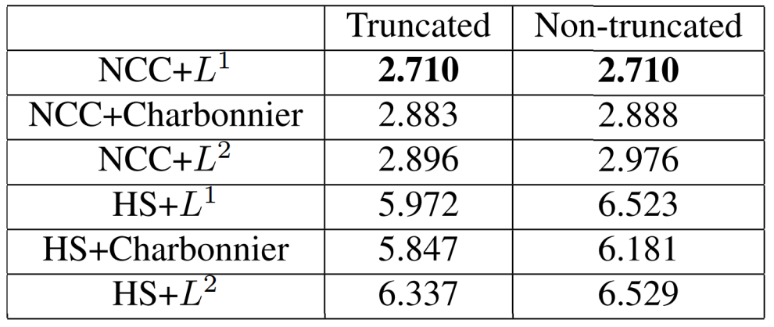
Controlled experiments
general-purpose optimization
  different data and regularization terms
Controlled evaluation
Sorted average EPE for each image
Notes:
Our optimization framework is so general that we can easily conduct a comprehensive evaluation of different data terms and regularization terms.
We evaluate two data terms: the patch-based normalized cross correlation and the classical pixelwise Horn-Schunck data term
We also evaluate three penalty functions for the regularization terms. We evaluate both truncated and non-truncated forms.
The results suggest that the data term is most important: the patch-based normalized cross correlation is much more effective than the pixelwise Horn-Schunck data term, regardless of the regularization terms.

Slide 18
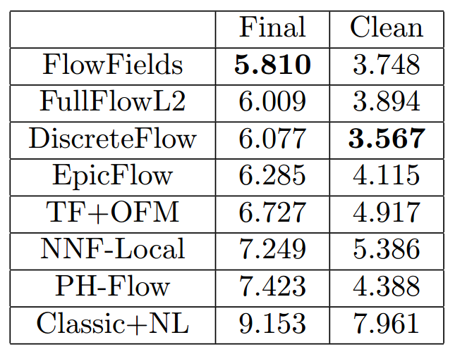
Horn-Schunck revisited
FullFlowL2 (HS + Global optimization + NCC)
Endpoint errors over all pixels
Notes:
When we use the L2 regularization in the Horn-Schunck models, combined with the NCC data term. The performance is still state-of-the-art on the Sintel dataset.

Slide 19
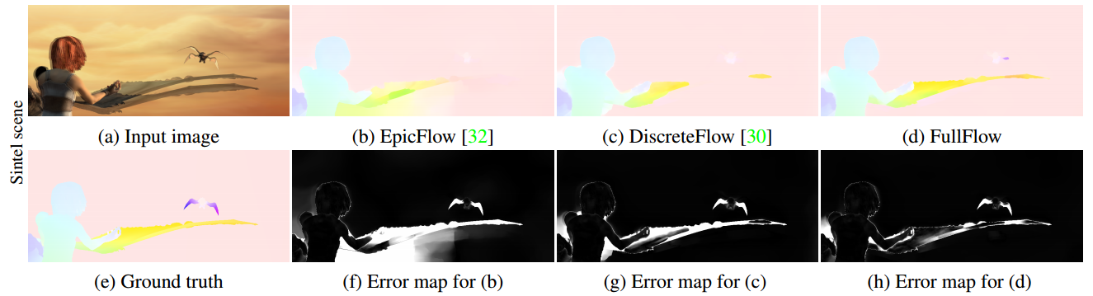
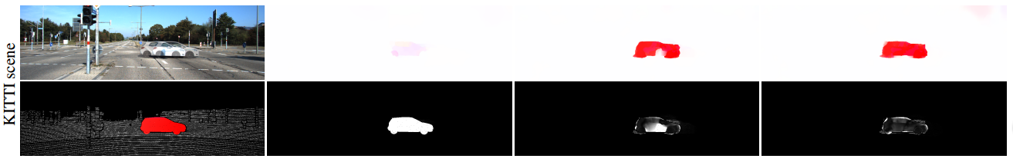
Qualitative results
Notes:
Here are our visual results compared to EpicFlow and DiscreteFlow on the scenes from Sintel and KITTI 2015 datasets. Please pay a close look at the red circles. The first column has input images and ground truth flow. The second column has the flow and error map for Epicflow. The third column has the results for Discrete flow and the last column is our results. Our approach performs well on regions with large displacements.

Slide 20
Summary
  Optimize over full regular grids
  classical objective
  state-of-the-art
Simple and general
  less than 50 lines of Matlab
Notes:
In summary, we have shown that globally optimizing a classical HornSchunck-type objective over full regular grids is sufficient to obtain state-of-the-art accuracy. In particular, this shows that state-of-the-art performance can be achieved without descriptors.
Our implementation is less than 50 lines long, excluding the general-purpose TRW-S solver. We hope the simplicity of our approach will support further advances.

Slide 21
Questions?
Source code
www.stanford.edu/~cqf/fullflow
Notes:
Here is the URL to the project website. Thank you! Do you have any question?

